Slide 1
Norwegian Association for Cardiothoracic Surgery
Thoracic surgery in Norway 2023
Norwegian register for general thoracic surgery.
Steinar Solberg, MD, PhD.
Department of Cardiothoracic Surgery
Rikshospitalet, Norway
ssolber@online.no

Slide 2
Synopsis for 2023
Slide
 | Data for 2023 from AHUS and Bodø are not available. Where possible, the median value for the three previous years (slides 4, 5, 10 and 12), or data from the Cancer registry (slide 11) have been used. Where proportions or time trends are presented, no estimation has been done (slides 6 – 9 and 13 – 16).
4 | The number of operations lies stable around 1500.
6 | The is still a reduction in the number of thoracotomies, and mini-invasive access is increasing.
8 | No operations on trachea have been reported in the last four years.
11-12 | The number of operations for lung cancer continues at a high level.
13 | No «Only exploration» for lung cancer has been reported.
15 | The slight increase in median age of those operated for lung cancer is mainly due to a reduction of surgery in the younger age groups.
 | Rikshospitalet, Ullevål (Oslo university hospital) cannot offer operations with robot.
Norwegian Association for Cardiothoracic Surgery

Slide 3
From the Cancer Registry of Norway 2023
Slide
18+20 | There has been a slight increase in 30-day operative mortality to 1,0% from 0,8 in 2022. Data for the last five years is presented for the first time.
22 | Any correlation between low 30-day mortality an selection of patients in low stage can be evaluated. Of 3297 diagnosed with lung cancer, 735 (22,3%) were operated.
21 | As for previous years, all operations are reported, and the time from surgery to sending report are now very low in most hospitals.
23 | The relative 5-years survival for patients operated is very good - 88,3% for patients in stage I. One year back it was 86.9%.
24 | The median time of surgery (skin-to-skin) was 120 minutes which is satisfying, but short surgery time should not be at the expence of removal of lymph nodes.
24 | The sampling of lymph nodes is increasing but is still disappointingly low in some hospitals.
25 | There is no differences between surgical acces in the patient’s reporting of their own health and quality of life six months after diagnosis.
Norwegian Association for Cardiothoracic Surgery

Slide 4
Number of general thoracic operations reported 2014-2023
Norwegian Association for Cardiothoracic Surgery

Slide 5
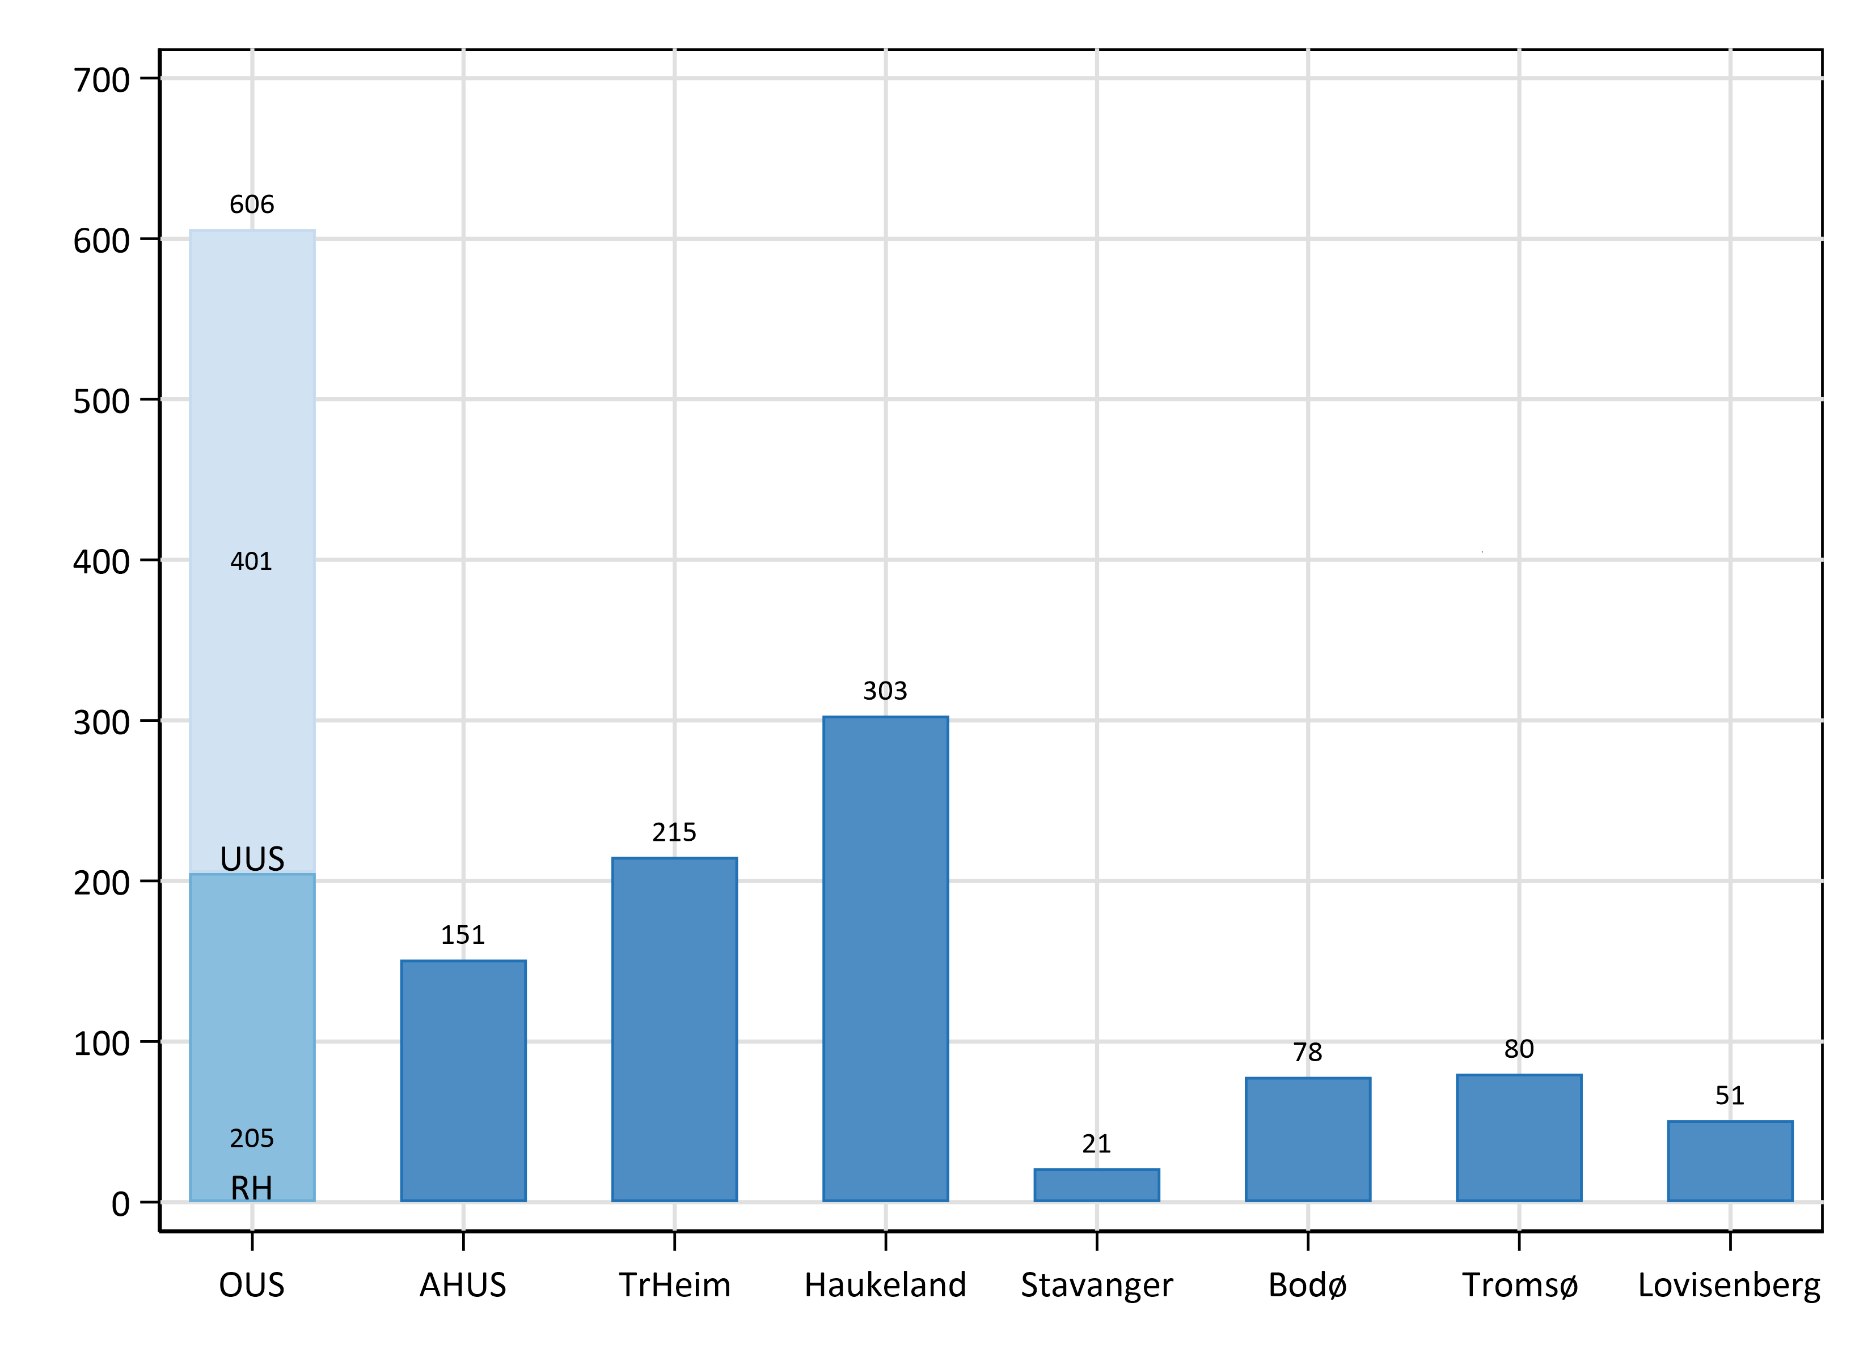
Number of general thoracic operations by hospital 2023
The figures for Rikshospitalet (RH) and Ullevål (UUS) are pooled as OUS

Slide 6
Access used 2004-2023
Number of operations performed by thoracotomy, thoracoscopy, robot, medistinoscopy and sternotomy
Norwegian Association for Cardiothoracic Surgery

Slide 7
Underlying diagnoses 2019-2023
Norwegian Association for Cardiothoracic Surgery

Slide 8
Organ operated upon 2019-2023
Norwegian Association for Cardiothoracic Surgery

Slide 9
Selected operations performed 2019-2023
Norwegian Association for Cardiothoracic Surgery

Slide 10
Number of operations for lung metastases performed 2014-2023
Norwegian Association for Cardiothoracic Surgery

Slide 11
Operations for lung cancer performed 2014-2024
*
*
The Cancer Registry has registered
735 operations in 2023
Norwegian Association for Cardiothoracic Surgery

Slide 12
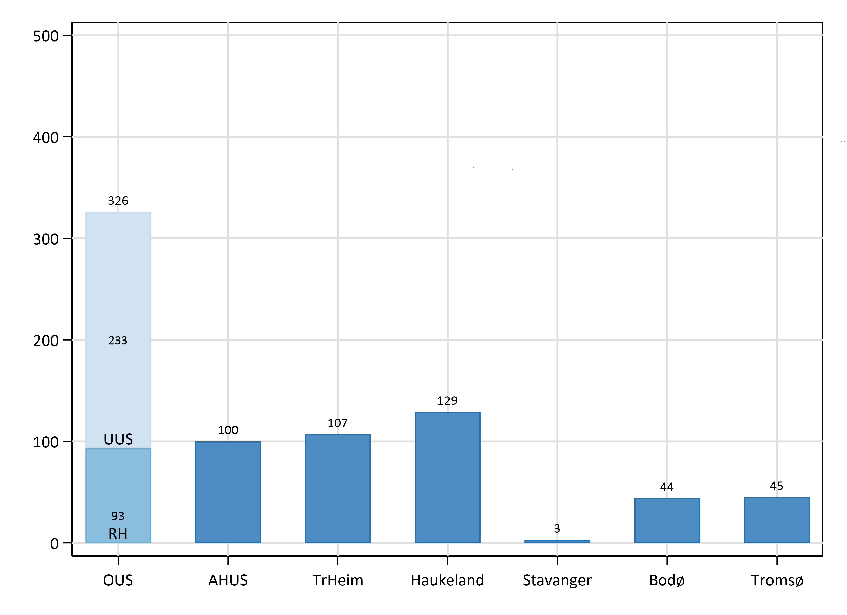
Number of operations for lung cancer by hospital 2023
The figures for Rikshospitalet (RH) and Ullevål (UUS) are pooled as OUS

Slide 13
Prosedures performed in operations for lung cancer 2019-2023
Norwegian Association for Cardiothoracic Surgery

Slide 14
The number (bars) and percentage females (line)
operated for lung cancer 2014-2023
Norwegian Association for Cardiothoracic Surgery

Slide 15
Age (percentiles with linear trendlines) in 11969 patients
operated for lung cancer 2003 - 2023
Norwegian Association for Cardiothoracic Surgery

Slide 16
The number of operation for lung cancer as proportion of the total
number of operations in general thoracic surgery 2014-2023
Norwegian Association for Cardiothoracic Surgery

Slide 17
The Cancer Registry
The complete annual report for lung cancer, 2023 can be found at:
https://www.kreftregisteret.no/globalassets/publikasjoner-og-rapporter/arsrapporter/publisert-2024/arsrapport-2023-nasjonalt-kvalitetsregister-for-lungekreft.pdf

Slide 18
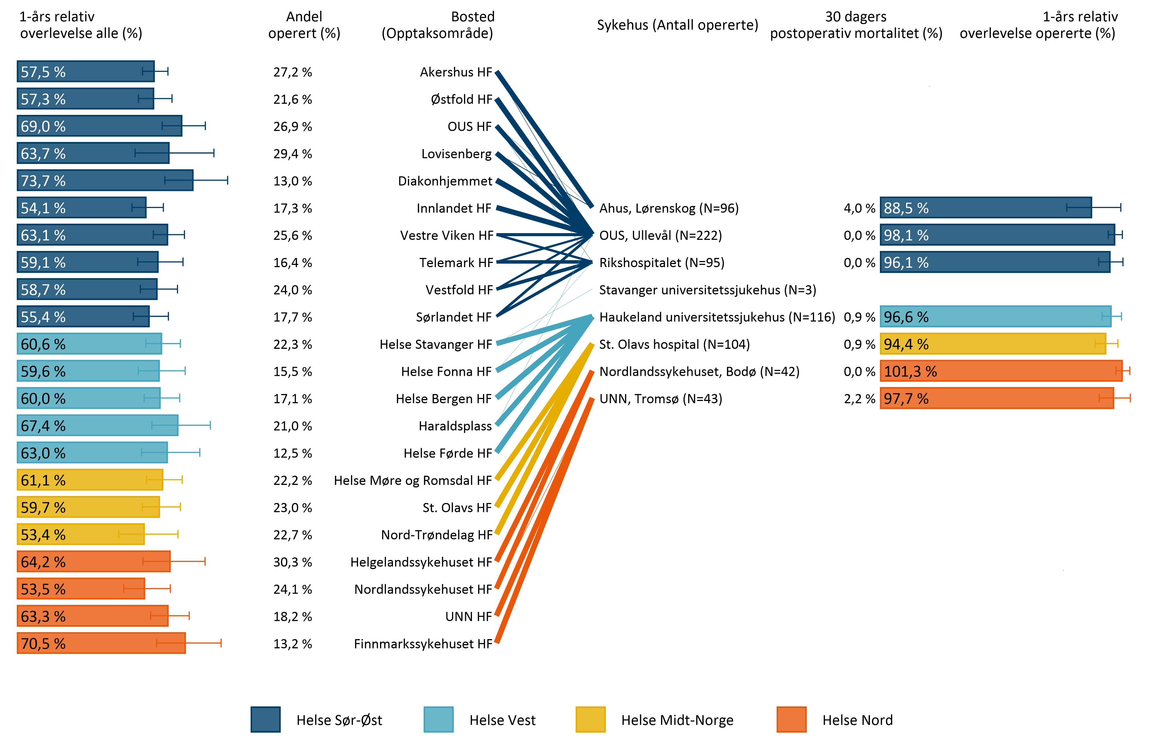
From The Cancer Registry
Pasientflyt for pasienter operert for lungekreft i 2023

Slide 19
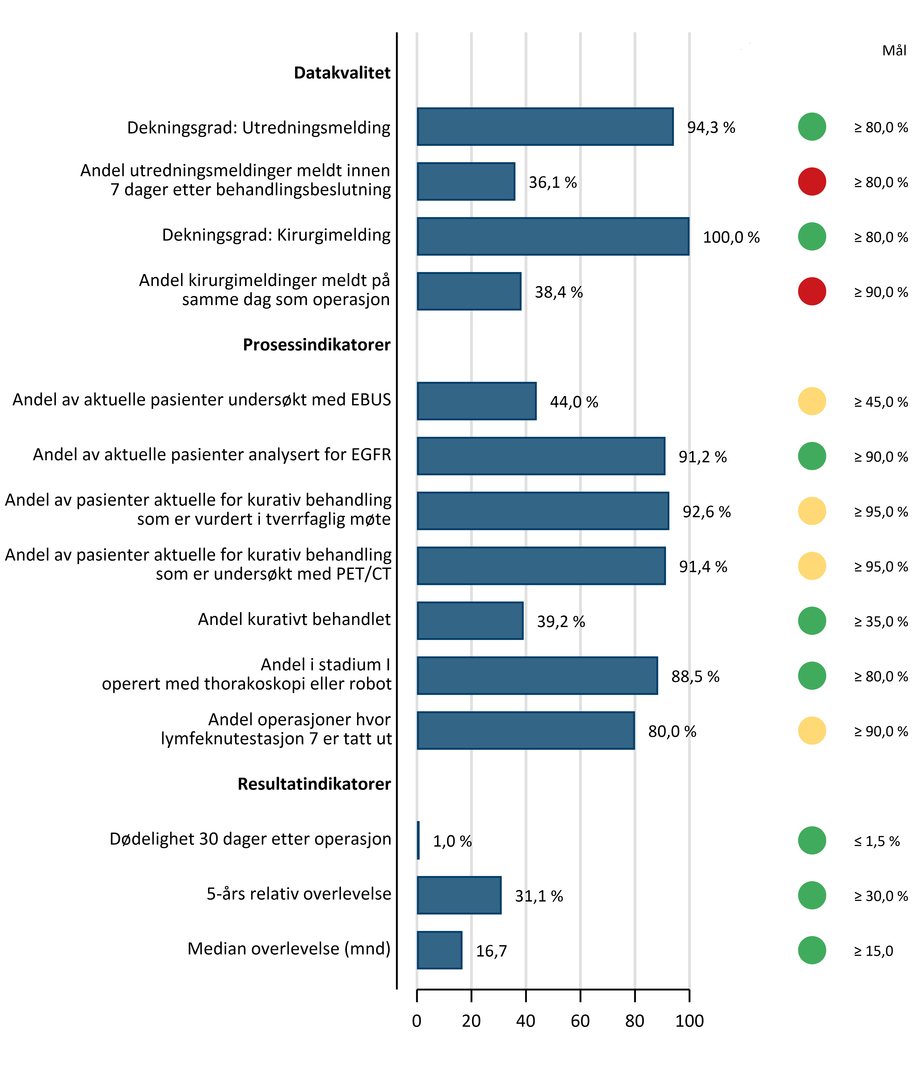
From The Cancer Registry
Kvalitetsindikatorer 2023

Slide 20
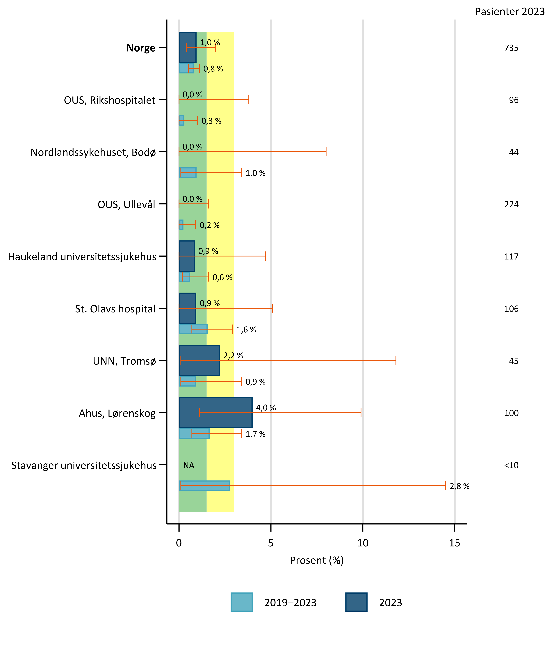
From The Cancer Registry
30 day operative mortality, 2019–2023.

Slide 21
From The Cancer Registry
Number of operations in the 5-years periode in brackets after hospital name

Slide 22
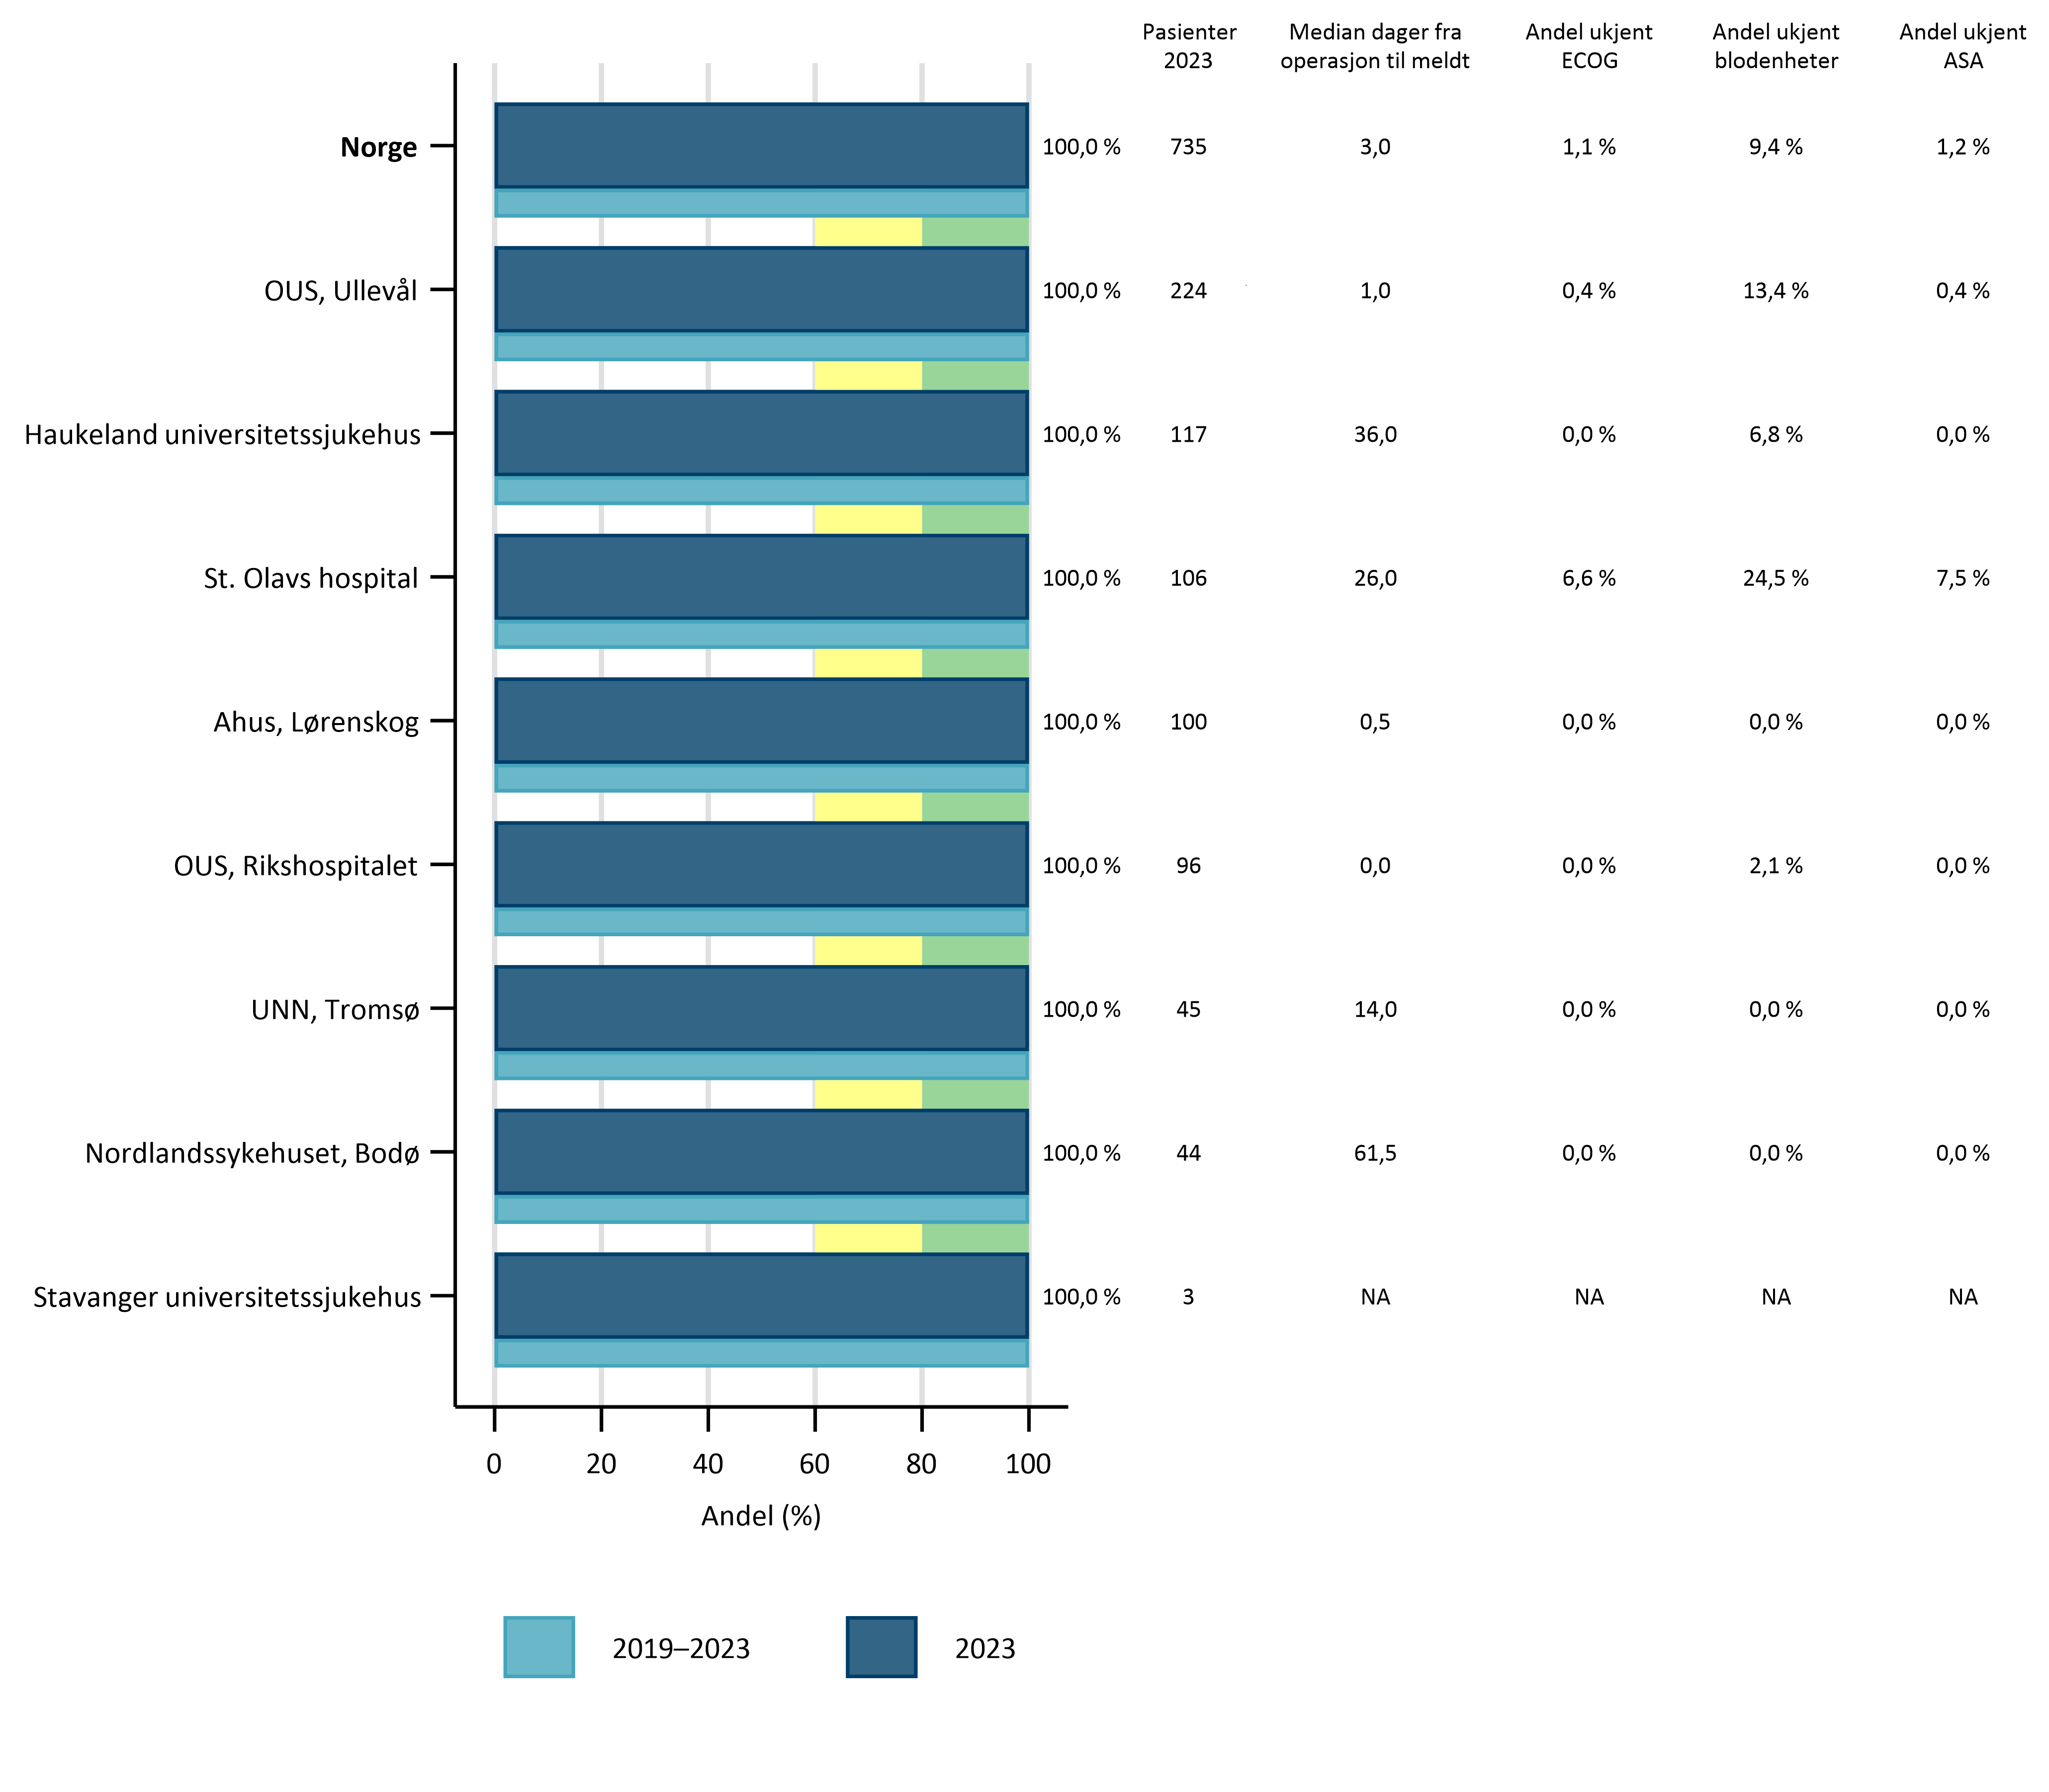
From The Cancer Registry
Rapportering kirurgimelding, 2023

Slide 23
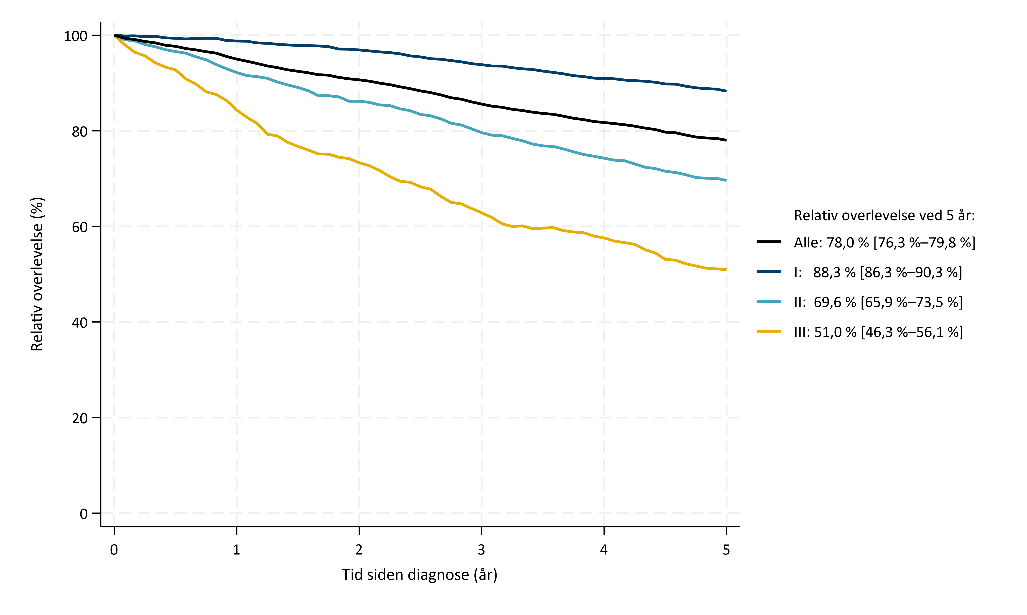
From The Cancer Registry
Relativ overlevelse opp til fem år etter operasjon
ved de ulike stadiene (pTNM) 2019-2023

Slide 24
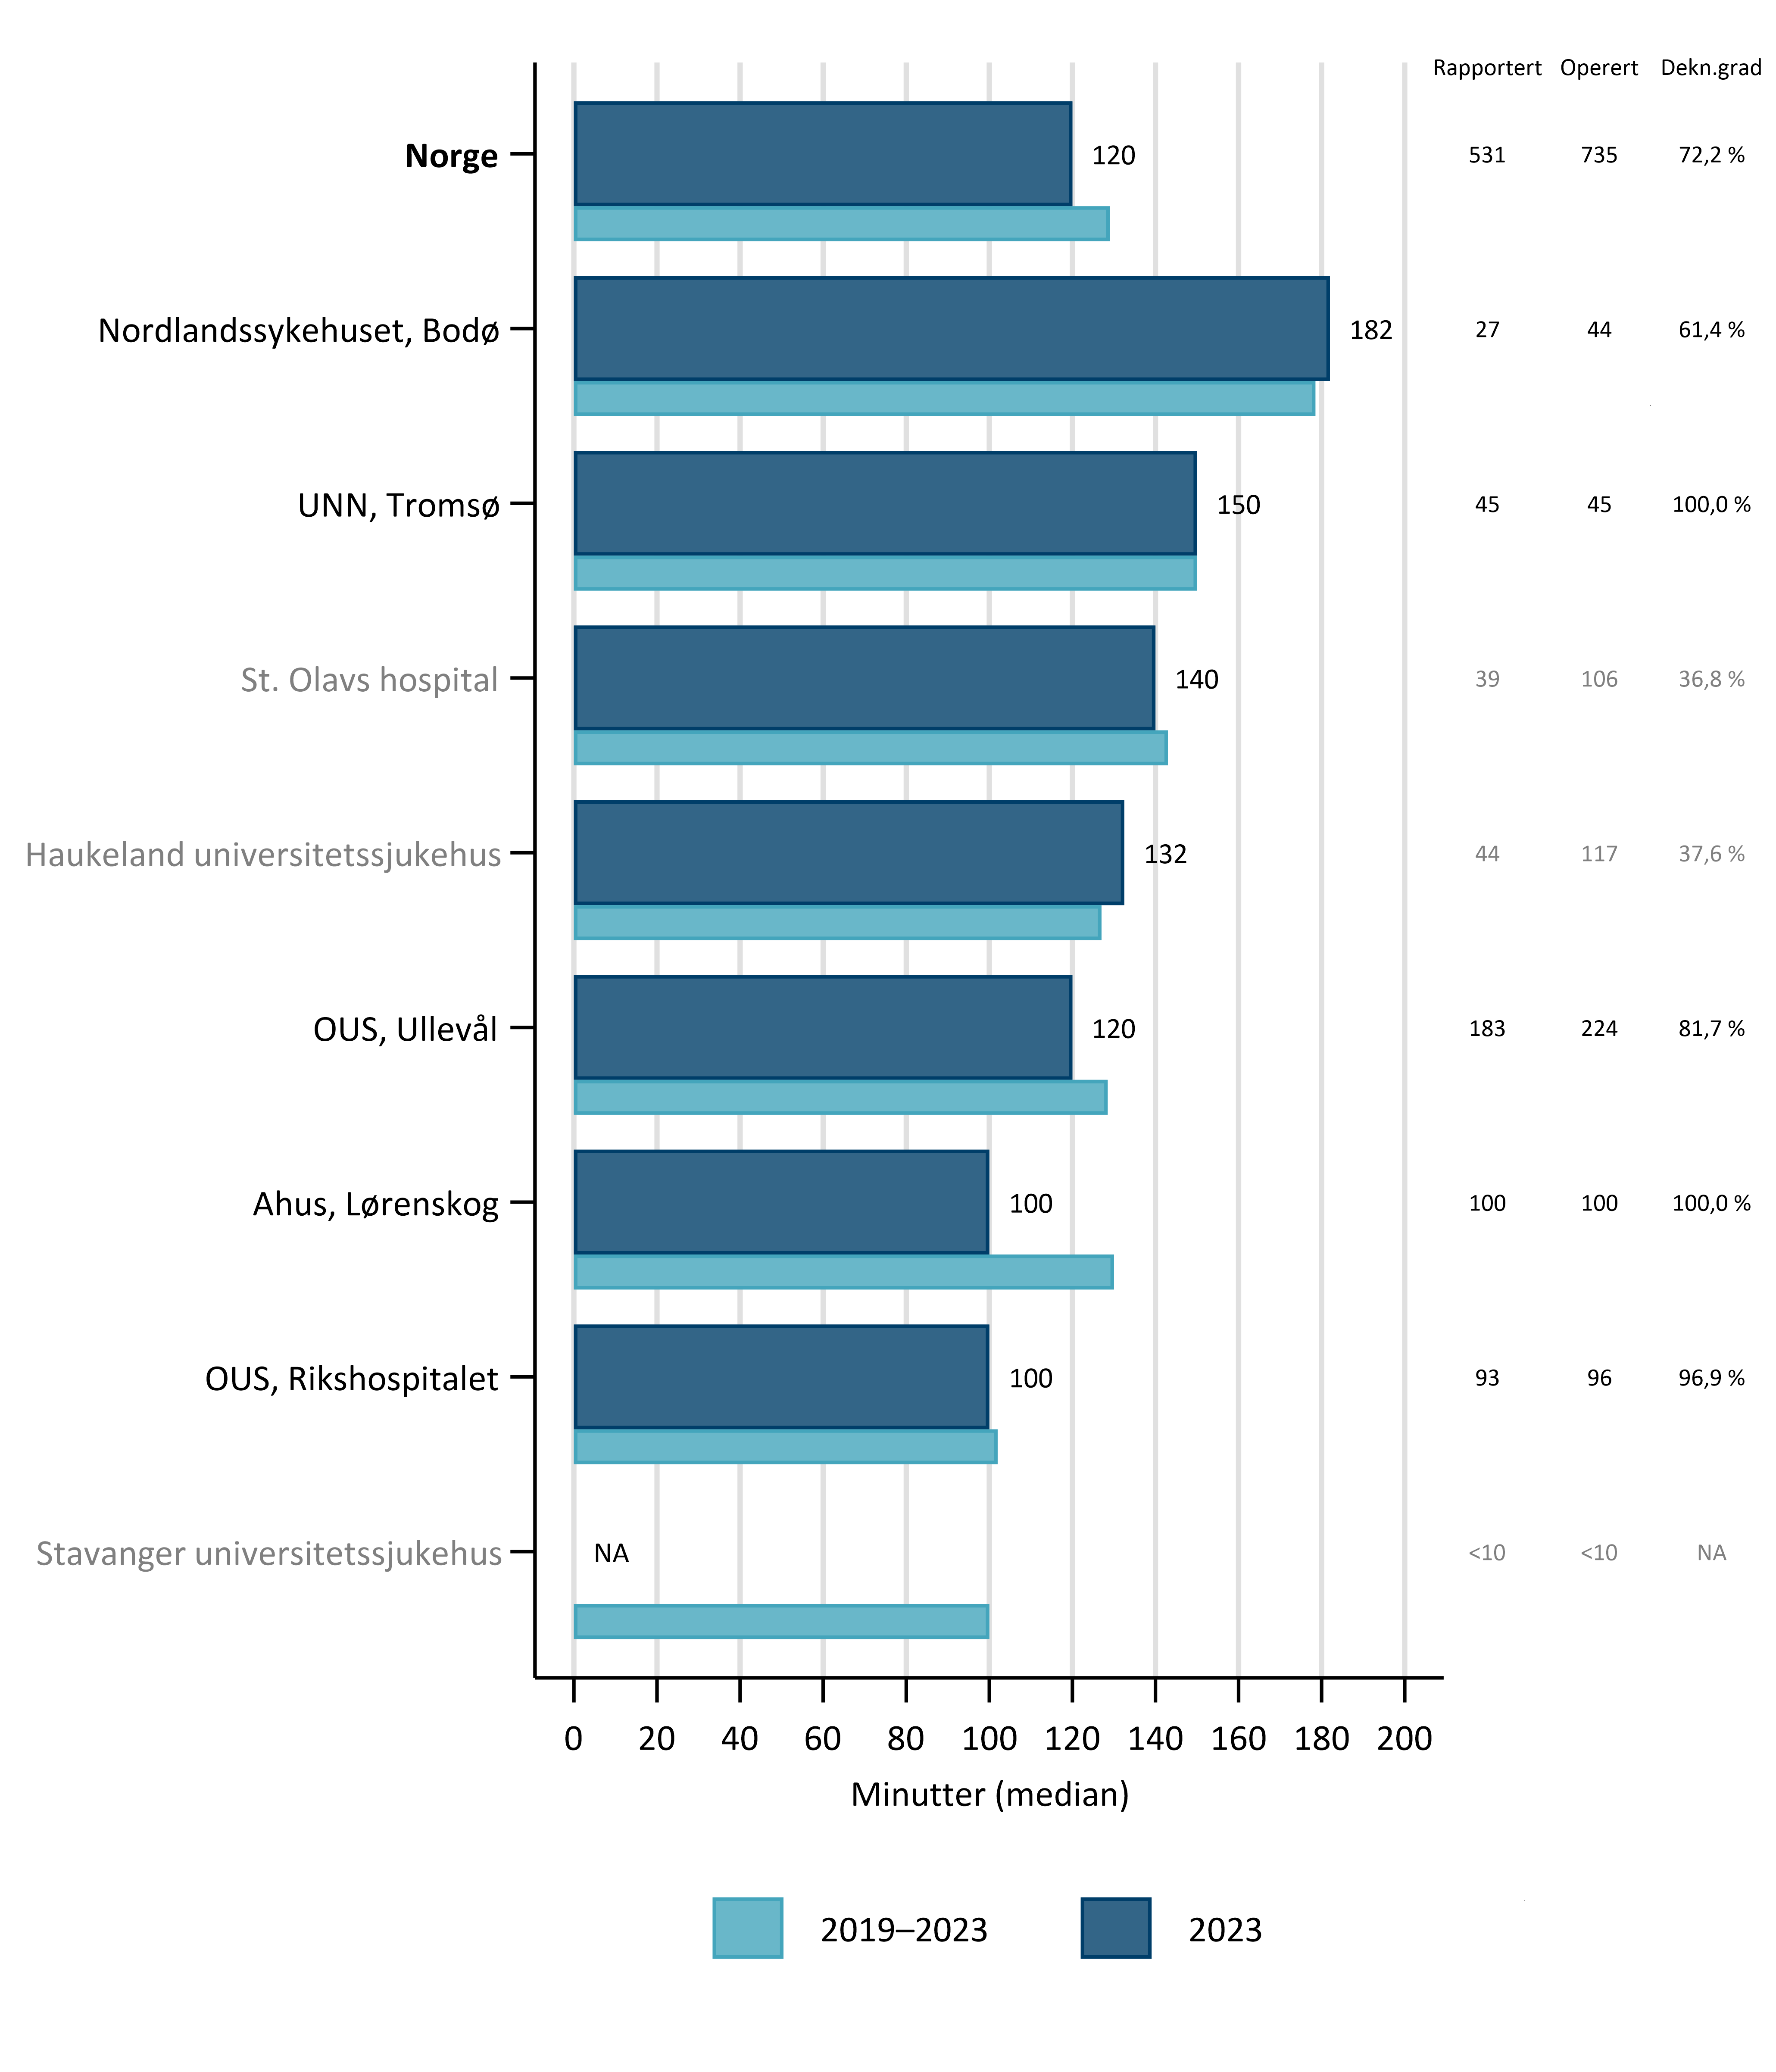
Surgery – time (minutes, skin to skin)
From The Cancer Registry

Slide 25
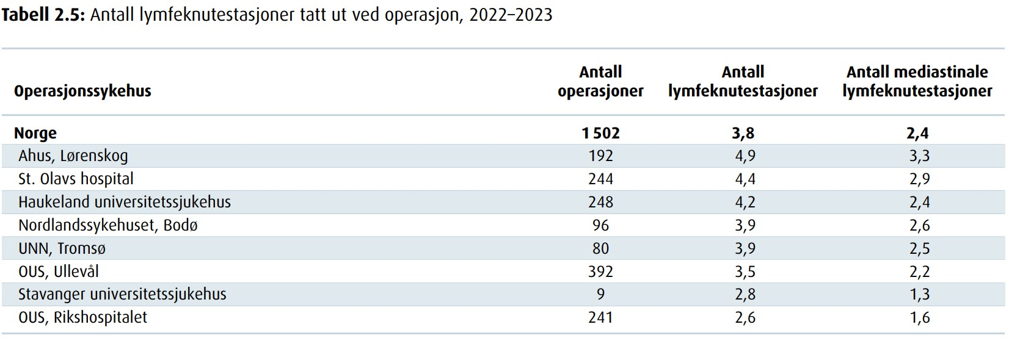
LYMPH NODES
From The Cancer Registry

Slide 26
From The Cancer Registry
Figur 2.28: Egenvurdert helse og livskvalitet hos opererte
lungekreftpasienter, seks måneder etter diagnose

Slide 27
T H A N K Y O U

